Slide 1
CHINOOK MUSIC STORE
Data Analysis & Growth Recommendations
Prepared by Kunal Gaulkar

Slide 2
Problem statement
You are hired as a data analyst at Chinook, and your objective is to analyze music record sales data to gain insights and make recommendations for the company's strategy in the physical music market.

Slide 3
Data description
customer:
customer_id: Unique identifier assigned to each customer.
first_name: The given name or first name of a customer.
last_name: The surname or family name of a customer.
company: The name of the company associated with a customer.
address: The street address of a customer's location.
city: The city where a customer is located.
state: The state or province where a customer is located.
country: The country where a customer is located.
postal_code: The postal or zip code of a customer's address.
phone: The phone number of a customer.
fax: The fax number associated with a customer.
email: The email address of a customer.
support_rep_id: The employee ID of the support representative assigned to a customer.
invoice:
invoice_id: Unique identifier assigned to each invoice.
customer_id: The customer ID associated with the invoice.
invoice_date: The date when the invoice was generated or issued.
billing_address: The street address used for billing purposes.
billing_city: The city used for billing purposes.
billing_state: The state or province used for billing purposes.
billing_country: The country used for billing purposes.
billing_postal_code: The postal or zip code used for billing purposes.
total: The total amount due on the invoice.

Slide 4
Data description
invoice:
invoice_id: Unique identifier assigned to each invoice.
customer_id: The customer ID associated with the invoice.
invoice_date: The date when the invoice was generated or issued.
billing_address: The street address used for billing purposes.
billing_city: The city used for billing purposes.
billing_state: The state or province used for billing purposes.
billing_country: The country used for billing purposes.
billing_postal_code: The postal or zip code used for billing purposes.
total: The total amount due on the invoice.
invoice_line:
invoice_line_id: Unique identifier assigned to each line item on an invoice.
invoice_id: The invoice ID to which the line item belongs.
track_id: The ID of the track or product included in the line item.
unit_price: The price per unit for the line item.
quantity: The quantity of units for the line item.
playlist:
playlist_id: Unique identifier assigned to each playlist.
name: The name or title of the playlist.
playlist_track:
playlist_id: The ID of the playlist to which the track belongs.
track_id: The ID of the track included in the playlist.
track:
track_id: Unique identifier assigned to each track or song.
name: The title or name of the track.
album_id: The ID of the album to which the track belongs.
media_type_id: The ID of the media type associated with the track.
genre_id: The ID of the genre associated with the track.
composer: The name of the composer or artist who composed the track.
milliseconds: The duration of the track in milliseconds.
bytes: The file size of the track in bytes.
unit_price: The price per unit for the track.

Slide 5
Data description
album:
album_id: Unique identifier assigned to each album.
title: The title or name of the album.
artist_id: The ID of the artist associated with the album.
artist:
artist_id: Unique identifier assigned to each artist.
name: The name of the artist.
media_type:
media_type_id: Unique identifier assigned to each media type.
name: The name or description of the media type (e.g., MPEG audio file, AAC audio file).
genre:
genre_id: Unique identifier assigned to each genre.
name: The name or description of the genre (e.g., rock, pop, classical).

Slide 6
AGENDA
What this deck covers
01
02
03
04
Project scope & method
Who the customers are
What sells
Recommendations
How the database was explored and what questions were asked
Geography, spend, loyalty and churn
Genres, artists, albums and cross-sell patterns
Where to focus promotion and retention effort
2

Slide 7
OVERVIEW
Chinook is a small, global digital music store
The dataset covers customers, invoices, tracks, albums, artists and genres across roughly 24 countries.
The analysis set out to answer two kinds of questions:
Objective - what does the data literally say (top sellers, revenue, churn, nulls)
Subjective - what should the business do about it (promotion, retention, cross-sell)
24+
59
Countries
Customers analyzed
37.3%
53%
90-day churn rate
of USA sales is Rock
3

Slide 8
METHOD
How the analysis was done
1
2
3
4
Map the schema
Check data quality
Query in MySQL
Interpret for the business
Reviewed how customer, invoice, invoice_line, track, album, artist and genre relate before writing queries.
Used information_schema and null counts to confirm the fields that matter (contact info, totals) are complete.
Joins, window functions (RANK, ROW_NUMBER) and CTEs to answer 23 objective and subjective questions.
Every query result was translated into a plain-language takeaway and, where useful, a recommendation.
4

Slide 9
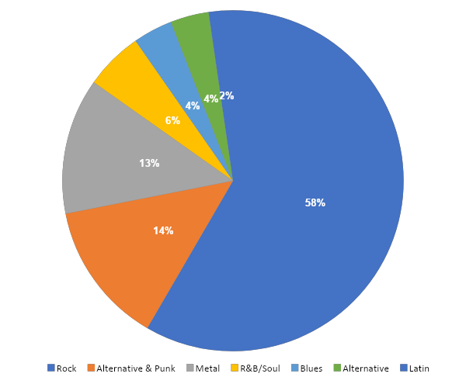
PRODUCT PERFORMANCE
Rock drives over half of all USA sales
Rock, Alternative & Punk and Metal together = ~78% of USA revenue.
This concentration shows up across most other countries too - it isn't a US-only pattern.
Everything past the top 3 genres is long-tail - a small, steady contributor rather than a growth lever.
Implication: promotion budget goes furthest sticking with proven Rock/Metal catalog, at least for now.
5

Slide 10
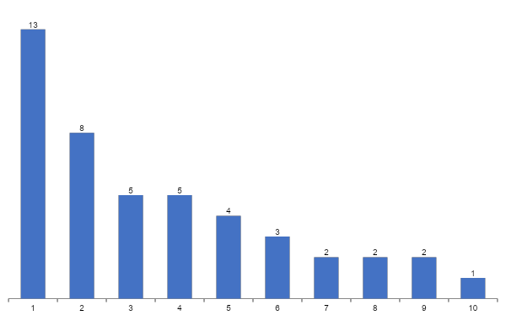
CUSTOMER BASE
A small customer base spread across many countries
USA leads, but no single country dominates.
Most countries have just 1-2 customers each - a wide, thin footprint.
Age and gender aren't in the schema - location is the only demographic lens available today.
Growth likely comes from deepening a few markets (USA, Canada, Brazil), not chasing more countries.
6

Slide 11
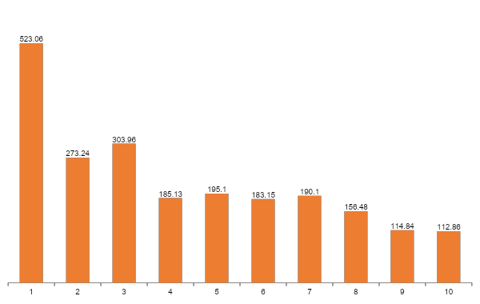
REVENUE
USA and Canada lead on total revenue
Revenue mostly tracks customer count - with one exception.
Czech Republic punches above its weight - only 2 customers but the 2nd highest revenue.
Those customers are worth understanding better - what they buy and why they spend more.
7

Slide 12
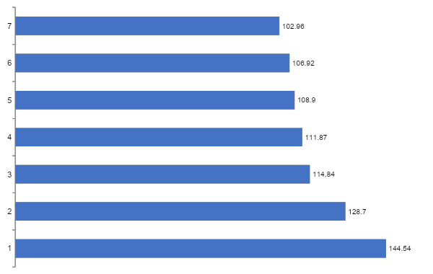
CUSTOMER VALUE
Frequency drives value more than basket size
Top spenders average $8-11 per order - not unusually high.
What sets them apart is how often they buy (12-18 purchases), not how much per order.
A frequency-based loyalty reward (e.g. every 10th purchase) fits this behavior better than a spend threshold.
8

Slide 13
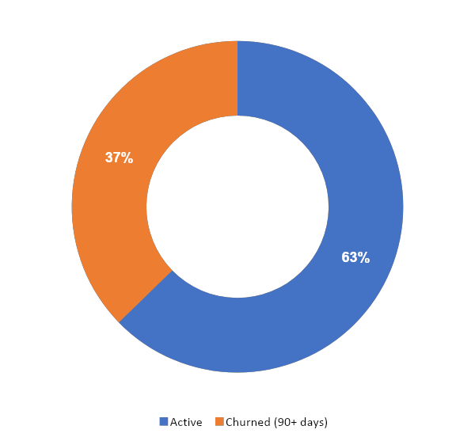
RETENTION
Over a third of customers have gone quiet
Churn = no purchase in 90+ days.
22 of 59 customers analyzed fall into this bucket - a high rate for a low-frequency category like music downloads.
These customers weren't necessarily low-value before they went quiet - several had solid purchase histories.
Recency, not spend level, is the strongest churn signal in this data.
37.3%
9

Slide 14
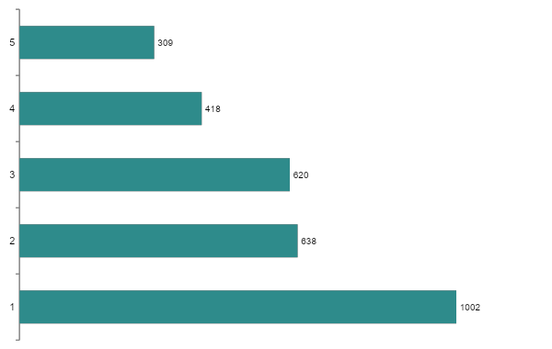
CROSS-SELL
Metal and Rock are bought together constantly
Genre pairings are a ready-made recommendation engine.
"If you liked this Rock track, try this Metal track" is backed directly by purchase history.
At the artist level pairs get eclectic (Green Day + Led Zeppelin) - customers shop by mood or era as much as by genre.
Worth testing mood/era playlists alongside genre-based ones.
10

Slide 15
RISK
Risk is driven by recency, not by how much someone spends
Risk Level | Rule | What it means
High Risk | No purchase in 12+ months | Treat as a win-back target regardless of past spend
Medium Risk | Frequency ≤ 2, or spend below average | Early warning - hasn't lapsed yet, but engagement is thin
Low Risk | Everyone else | Healthy, recently active customers
Why this matters:
High Risk customers in this data often had decent purchase histories before going quiet.
That means a spend-based offer (e.g. "spend $50, get 10% off") misses them - a simple "we miss you" nudge timed to their lapse point works better.
11

Slide 16
LOYALTY
This is a retention business, not an acquisition business
59
Almost no new customers show up in this window.
The existing base is doing the heavy lifting - keeping them engaged matters more than chasing new sign-ups right now.
Basket size is modest and steady ($7.76 avg) - loyal customers buy often, not big.
A frequency-reward loyalty program fits this pattern better than a spend-tier program.
of the customers analyzed are
LONG-TERM (first purchase over a year ago)
Avg. purchase frequency: 10.4 orders
Avg. basket size: $7.76
Avg. total spend: $79.82
12

Slide 17
RECOMMENDATIONS
Four things worth doing next
Lead USA promotion with proven Rock albums
Are You Experienced? (Hendrix), From The Muddy Banks of the Wishkah (Nirvana) and The Doors already outsell everything else - the safest bet for ad spend.
Launch a recency-triggered win-back campaign
37% churn and several high-value lapsed customers point to an automated "we miss you" flow triggered at 60-90 days idle, not a generic discount blast.
Build a frequency-based loyalty program
Loyal customers buy often, not big. Reward the 10th purchase, not the $50 cart.
Use genre and artist pairings for cross-sell
Metal-Rock and similar pairings are backed by real purchase data - a ready-made "customers also bought" feature.
13

Slide 18
CAVEATS
What this analysis can't tell us yet
Small samples: many countries have only 1-2 customers, so per-country averages are directional, not statistically solid.
No age, gender, or payment-method data: the schema doesn't capture these, so demographic and payment-pattern questions are only partly answerable.
Churn window (90 days) and CLV formula are reasonable starting assumptions, not derived from a formal cohort study - worth revisiting as more data comes in.
No campaign data exists yet: to measure promotion impact properly, a campaigns table (channel, dates, cost) linked to invoices is needed.
14

Slide 19
Thank you
Questions welcome.

